Slide 1
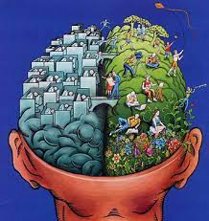
Logic: formal and informal definitions. The spheres of its applications (with precise and detailed examples).
Created by:
Iruna Sadovska,
DA-92 group

Slide 2
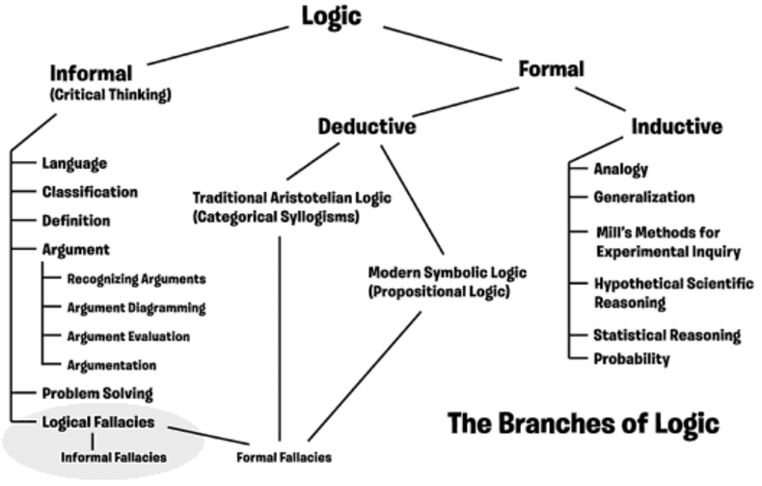

Slide 3
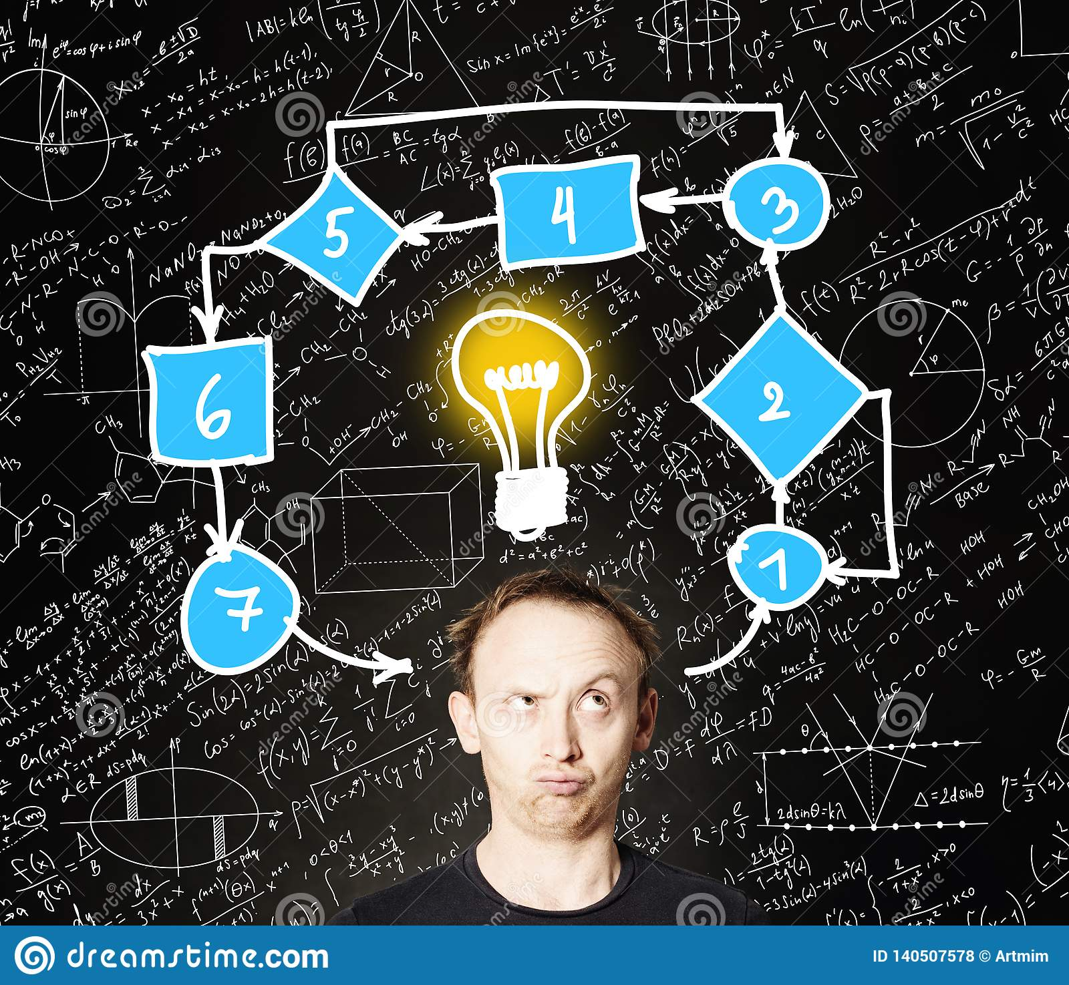
Formal definition of logic
Formal logic is the study of inference with purely formal content. An inference possesses a purely formal and explicit content (i.e. it can be expressed as a particular application of a wholly abstract rule) such as, a rule that is not about any particular thing or property. In many definitions of logic, logical consequence and inference with purely formal content are the same.

Slide 4
Examples of formal logic include (1) traditional syllogistic logic (a.k.a. term logic) and (2) modern symbolic Logic:
Syllogistic logic can be found in the works of Aristotle, making it the earliest known formal study and studies types of syllogism. Modern formal logic follows and expands on Aristotle.
Symbolic logic is the study of symbolic abstractions that capture the formal features of logical inference, often divided into two main branches: propositional logic and predicate logic.

Slide 5
Syllogistic logic
the formal analysis of logical terms and operators and the structures that make it possible to infer true conclusions from given premises.
An example of a syllogism is "All mammals are animals. All elephants are mammals. Therefore, all elephants are animals." In a syllogism, the more general premise is called the major premise ("All mammals are animals"). The more specific premise is called the minor premise ("All elephants are mammals").

Slide 6
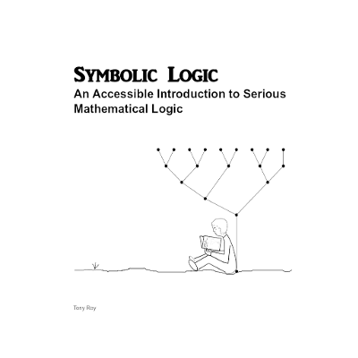

Slide 7
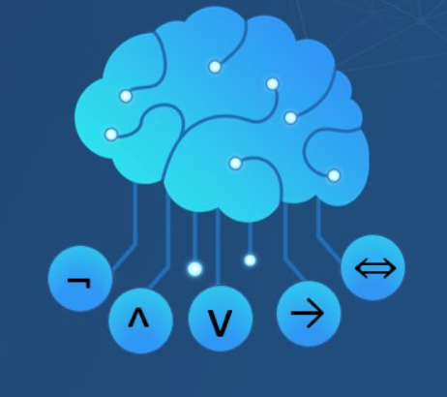
Propositional logic
Deals with propositions (which can be true or false) and relations between propositions, including the construction of arguments based on them.
Compound propositions are formed by connecting propositions by logical connectives.
Propositions that contain no logical connectives are called atomic propositions.

Slide 8

Propositional logic
A proposition is a declarative sentence that is either true (denoted either T or 1) or false (denoted either F or 0).
Variables are used to represent propositions. The most common variables used are p, q, and r.
Example: "The U. S. holds presidential elections every four years." "Bob bought a new car." "Suzanne has the measles." "More than forty ...

Slide 9
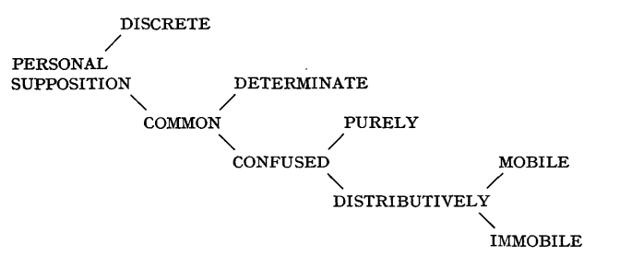
Predicate logic
is an expression of one or more variables determined on some specific domain.
A predicate with variables can be made a proposition by either authorizing a value to the variable or by quantifying the variable.

Slide 10
What is formal logic used for?
Evaluation/Checking (to evaluate validity of arguments);
Clarification/Specification (to express things in a precise and unambiguous way);
Demonstrating/Proof (to figure out what follows from a set of assumptions)
Computation/Automated Reasoning (for machine reasoning)

Slide 11
Examples of formal logic
1. Premises: Every person who lives in Quebec lives in Canada. Everyone in Canada lives in North America. Conclusion: Every person who lives in Quebec lives in North America.Explanation: Only true facts are presented here.
2. Premises: All spiders have eight legs. Black Widows are a type of spider. Conclusion: Black Widows have eight legs. Explanation: This argument isn’t controversial.
3. Premises: Bicycles have two wheels. Jan is riding a bicycle. Conclusion: Jan is riding on two wheels. Explanation: The premises are true and so is the conclusion.

Slide 12

Informal definition of logic
Informal logic encompasses the principle of logic and logical thought outside of a formal setting.
Informal logic is associated with (informal) fallacies, critical thinking, the thinking skills movement and the interdisciplinary inquiry known as argumentation theory.
Is the study of natural language arguments. The study of fallacies is an important branch of informal logic. Since much informal argument is not strictly speaking deductive, on some conceptions of logic, informal logic is not logic at all

Slide 13

Informal logic is what’s typically used in daily reasoning. This is the reasoning and arguments you make in your personal exchanges with others.

Slide 14
Examples of informal logic
1. Premises: Nikki saw a black cat on her way to work. At work, Nikki got fired. Conclusion: Black cats are bad luck. Explanation: This is a big generalization and can’t be verified.
2. Premises: There is no evidence that penicillin is bad for you. I use penicillin without any problems. Conclusion: Penicillin is safe for everyone. Explanation: The personal experience here or lack of knowledge isn’t verifiable.
3. Premises: My mom is a celebrity. I live with my mom. Conclusion: I am a celebrity. Explanation: There is more to proving fame that assuming it will rub off.

Slide 15
Conclusions

Slide 16
Subset of logic
Informal logic
Formal logic
Is used in everyday reasoning and argument analysis
Is deal with deductive reasoning and the validity of the intrfaces produced

Slide 17
Thanks for your attention!

